Slide 1
Docker Essentials
Notes:
https://courses.cs.washington.edu/courses/cse403/13au/lectures/git.ppt.pdf
http://enos.itcollege.ee/~jpoial/allalaadimised/git/getting-started-with-git.pdf

Slide 2
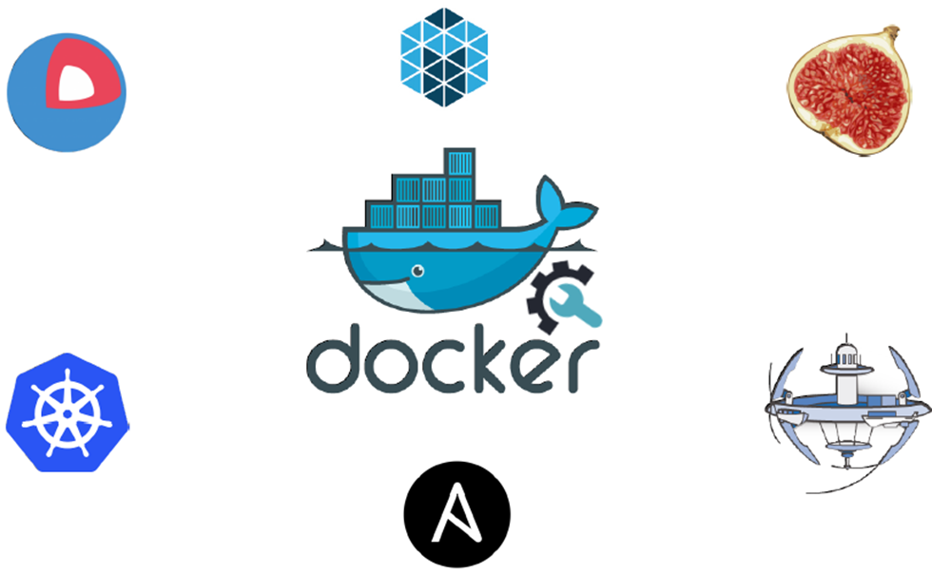
Docker

Slide 3
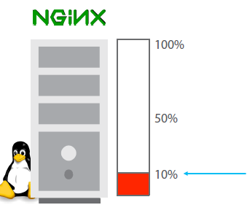
Less Utilization in Traditional Architecture

Slide 4
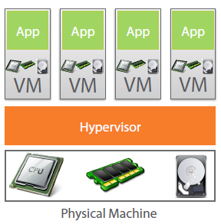
Virtual Machine to the Rescue

Slide 5
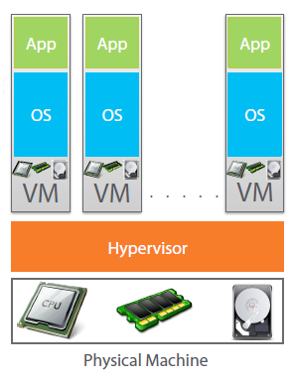
Each VM needs a separate OS

Slide 6
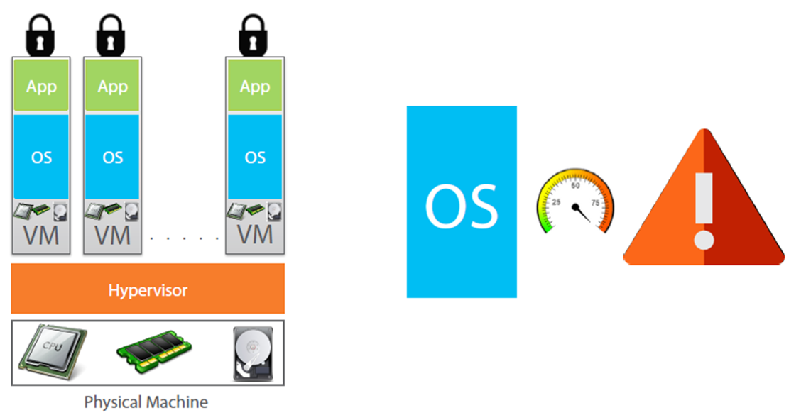
OS takes most of the Resources

Slide 7
Why use separate OS for each App?

Slide 8
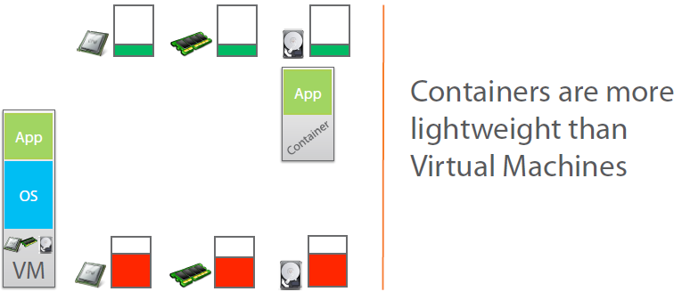
Containers to the Rescue

Slide 9
What is Docker?
Docker is an open-source project
that automates the deployment of applications inside software containers,
by providing an additional layer of abstraction and
automation of operating system–level virtualization on Linux.

Slide 10
Practical

Slide 11


